Slide 1
SOLID Object Oriented Design
Based on www.craigberntson.com/docs/SOLID.pptx
Eldar Sehayek https://www.linkedin.com/in/eldar-sehayek/

Slide 2

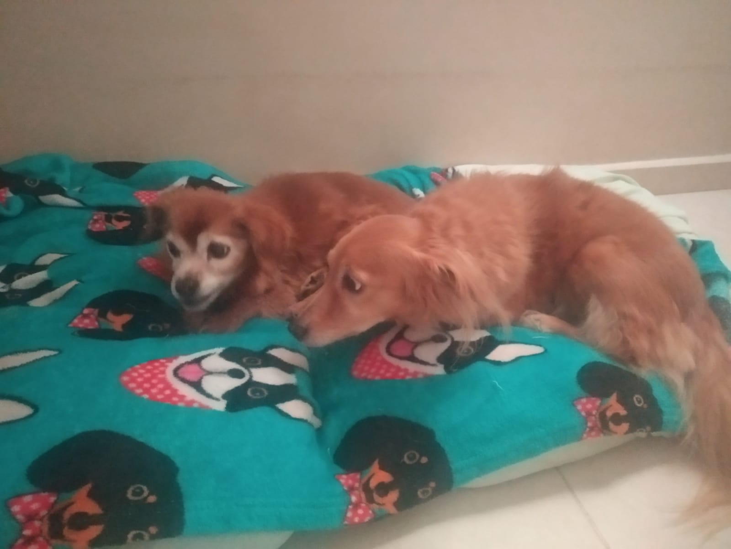
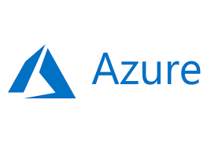
A bit about me
Notes:
Senior Software Engineer in MS, over 5 years in the company, over 11 years of experience total, specialized with backend and data engineering, C# and Azure expert
Passionate about OOP and mastering it for 9 years now
A dog person
Passionate about helping others and professional mentoring, doing it for 9 years as well

Slide 3

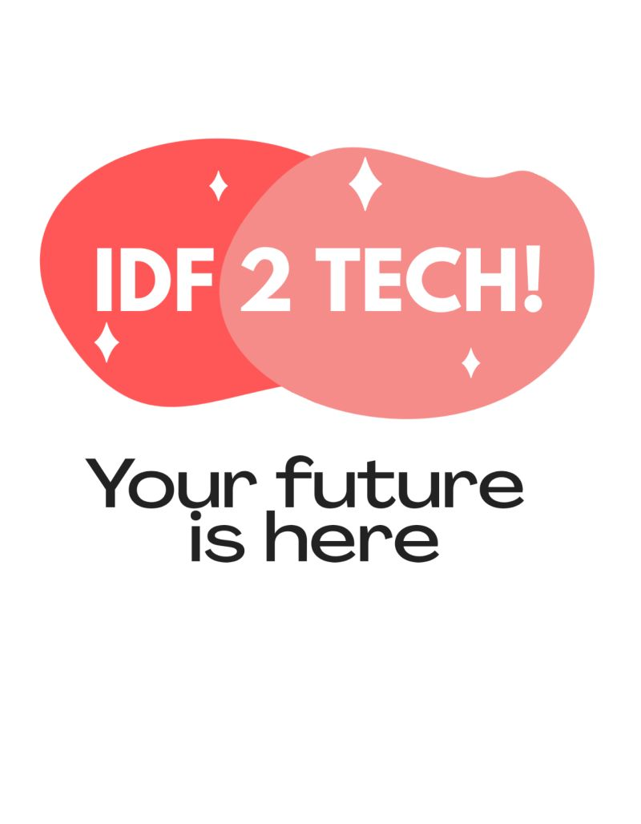
Giving is receiving
https://www.linkedin.com/company/idf-2-tech/?viewAsMember=true
https://www.facebook.com/groups/200762757982786/?ref=share
Notes:
This lecture is part of an OOP lecture series that I’ll conduct as part of collaboration between my volunteering COVID initiative IDF 2 TECH and the FB community Indsutry.Net which provides excellent exclusive context and led by Morag which I’ve come to respect as hell for creating such a professional and engaging community

Slide 4
Today’s session
Review basic OOP and smells
SOLID principles
SOLID in the cloud
Other agile/OOP principles

Slide 5
Basic OOP
Encapsulation
Inheritance
Polymorphism
Cohesion - How closely related are the different responsibilities of a module
Coupling - How much one module relies on another
Goal is low coupling and high cohesion

Slide 6
Code smells
God class
Feature Envy
Leaky abstraction
Primitive obsession
Temporal coupling

Slide 7
Design smells
Rigidity
Software is difficult to change
Fragility
Program breaks in many places when a change made in a single place
Immobility
Parts could be useful in other systems, but effort and risk to separate from original system is too great

Slide 8
Why does software rot?
Waterfall methodology
Requirements change
Evolving code bases suffer from entropy
We don’t take time to refactor
We aren’t proficient at OO design
Designs and practices are at fault

Slide 9
SOLID
Single Responsibility Principle (SRP)
Open-Closed Principle (OCP)
Liskov Substitution Principle (LSP)
Interface Segregation Principle (ISP)
Dependency Inversion Principle (DIP)

Slide 10
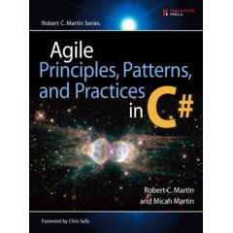
Where does SOLID come from?

Slide 11
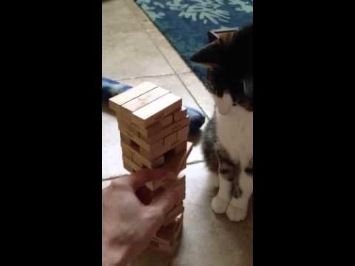
Jenga

Slide 12
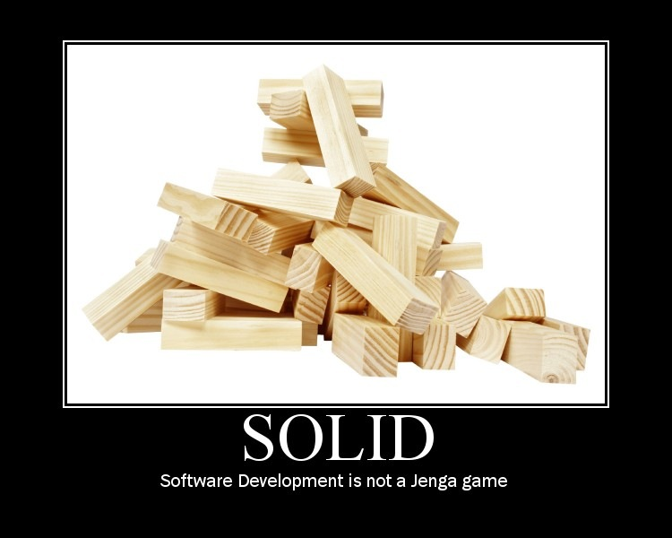

Slide 13
Single Responsibility Principle (SRP)
A class should have only one reason to change

Slide 14
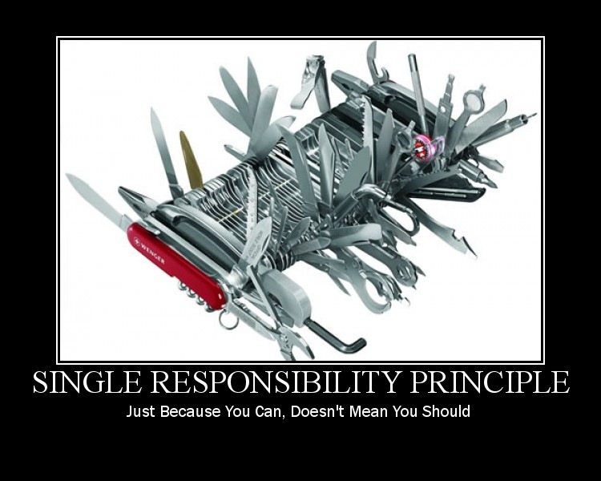

Slide 15
Responsibility
What a class does
The more a class does, the more likely it will change
The more a class changes, the more likely we will introduce bugs

Slide 16
Demo
Single Responsibility Principle

Slide 17
Open Closed principle (OCP)
Software entities (classes, modules, functions, etc.) should be open for extension but closed for modification

Slide 18
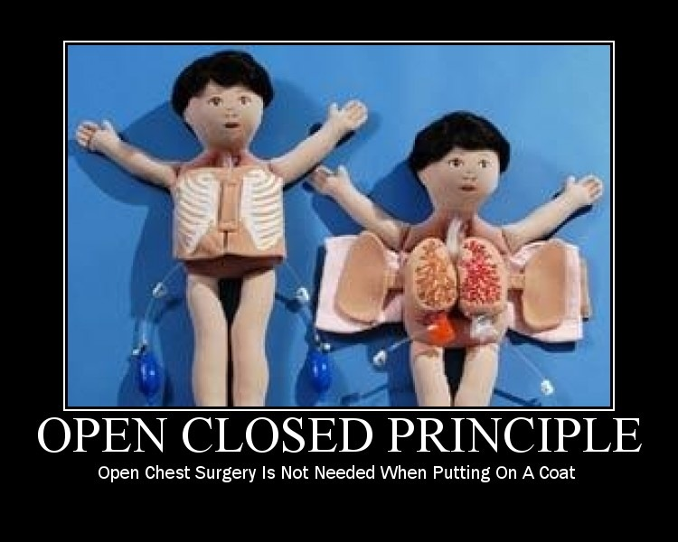

Slide 19
Conforming to OCP
Open for extension
Behavior of the module can be extended
We are able to change what the module does
Closed for modification
Extending behavior does not result in changes to source, binary, or code of the module

Slide 20
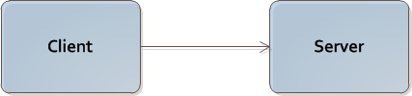
Does not conform to OCP
Client is not open and closed

Slide 21
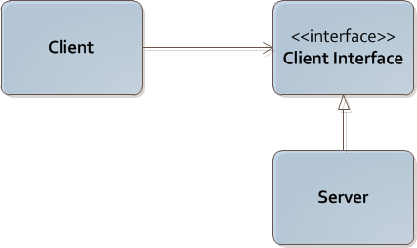
Strategy pattern
Client is both open and closed

Slide 22
Conforming to OCP
Rely on abstractions
Interfaces (full abstraction)
Abstract classes (partial abstraction)

Slide 23
Demo
Open Closed Principle

Slide 24
Liskov Substitution Principle (LSP)
Subtypes must be substitutable for their base types

Slide 25
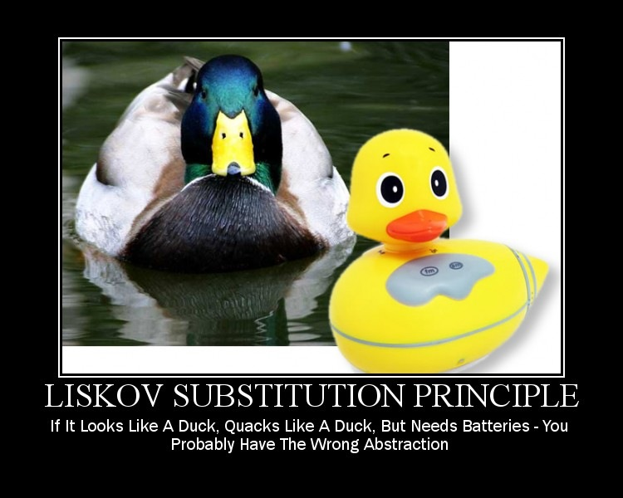

Slide 26
IS-A
Basic OOP discusses inheritance with “IS-A”
LSP says that “IS-A” refers to behavior
Behavior is what software is really all about

Slide 27
Substitution
Calling code should not know that one module is different from its substitute

Slide 28
Demo
Liskov Substitution Principle

Slide 29
Interface Segregation Principle (ISP)
Clients should not be forced to depend on methods they do not use

Slide 30
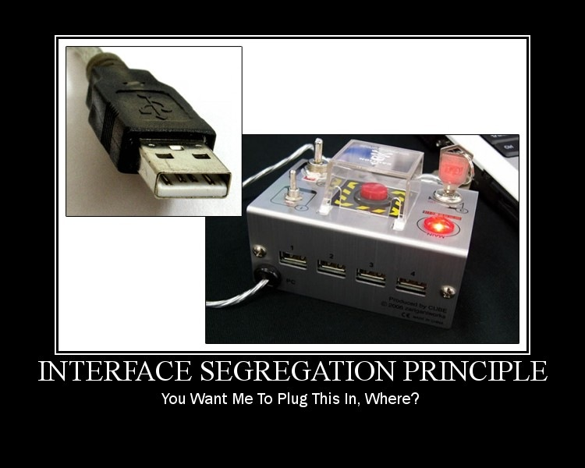

Slide 31
Demo
Interface Segregation Principle

Slide 32
Dependency Inversion Principle (DIP)
High-level modules should not depend on low-level modules. Both should depend on abstractions
Abstractions should not depend on details. Details should depend upon abstractions

Slide 33
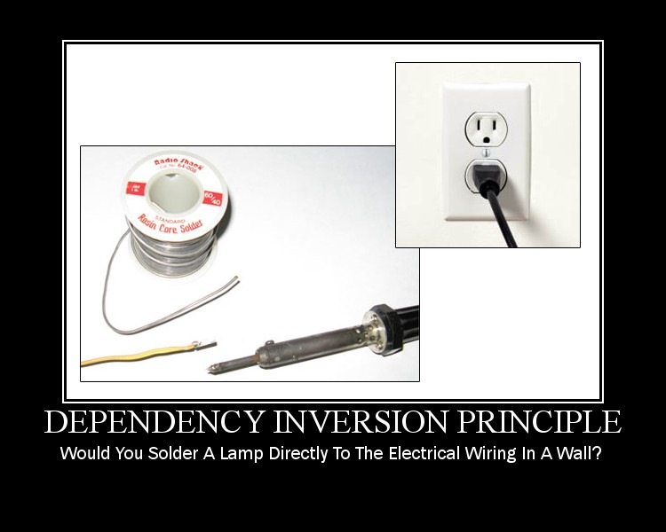

Slide 34
Demo
Dependency Injection Principle

Slide 35
Simplified dependencies graph

Slide 36
Where is the “new”?
Dependency Injection dictates that objects should depend upon abstractions, unaware of concrete implementations.
Dependencies should be “newed” before they are injected.

Slide 37
Here is the “new”
DI containers – factories on steroids, responsible for creating the implementations and injecting them, and there are plenty available!
Simple Injector
Unity
Windsor Castle

Slide 38
Other principles
Keep It Simple Stupid (KISS)
You Ain’t Gonna Need It (YAGNI)
Don’t Repeat Yourself (DRY
Reused Abstractions Principle (RAP)
Separation Of Concerns (SOC)
Principle Of Least Astonishment (POLA)
Generalization of Liskov Substitution Principle

Slide 39
Aim high, to the Cloud
Micro services
Independent scaling
Independent life cycles
Each micro service can be implemented in the most suitable language/framework
APIs exposed via standard protocols & formats
HTTP (REST), AMQP
Program to an interface, not an implementation

